Slide 1


Mitigating Climate Change
Week 9 - Global Climate Change EART21202
Dr Thomas Bannan
Thomas.Bannan@Manchester.ac.uk

Slide 2


Global Climate Change - 2026
Week 1 – Introduction to climate change and its impacts (5th Feb)
Week 2 – Natural climate variability (12th Feb)
Week 3 – Radiation Law/Greenhouse Effect/Radiative forcing/feedbacks (19th Feb)
Week 4 – Anthropogenic impacts (26th Feb)
Week 5 – The Evidence Base for Climate Change (5th March)
Week 6 – Mid Unit Test (10th March)
Week 7 – Climate Models (19th March)
Week 8 – Climate Change Adaptation (26th March)
Week 9 – Climate Change Mitigation (23rd April)
Week 10 – Effects of Climate Change: Case Studies (30th April)
Week 11 – Revision Lecture (7th May)
Exam - 18 May 2026, 9:45-11:15
Comments/Questions

Slide 3
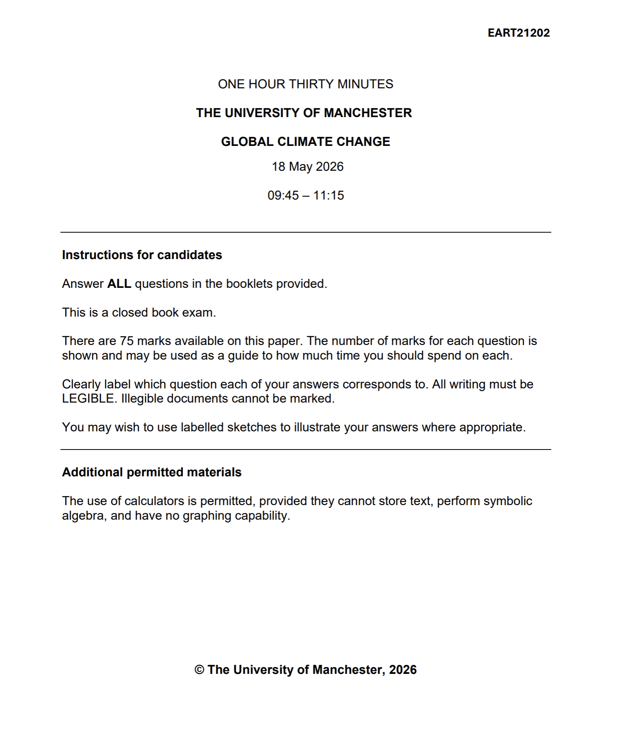
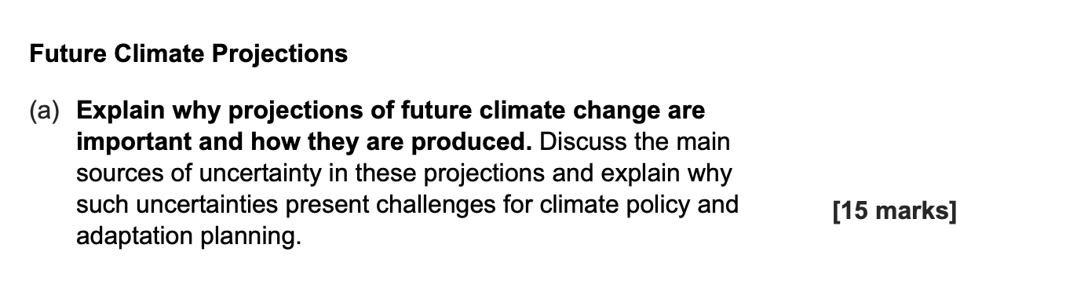
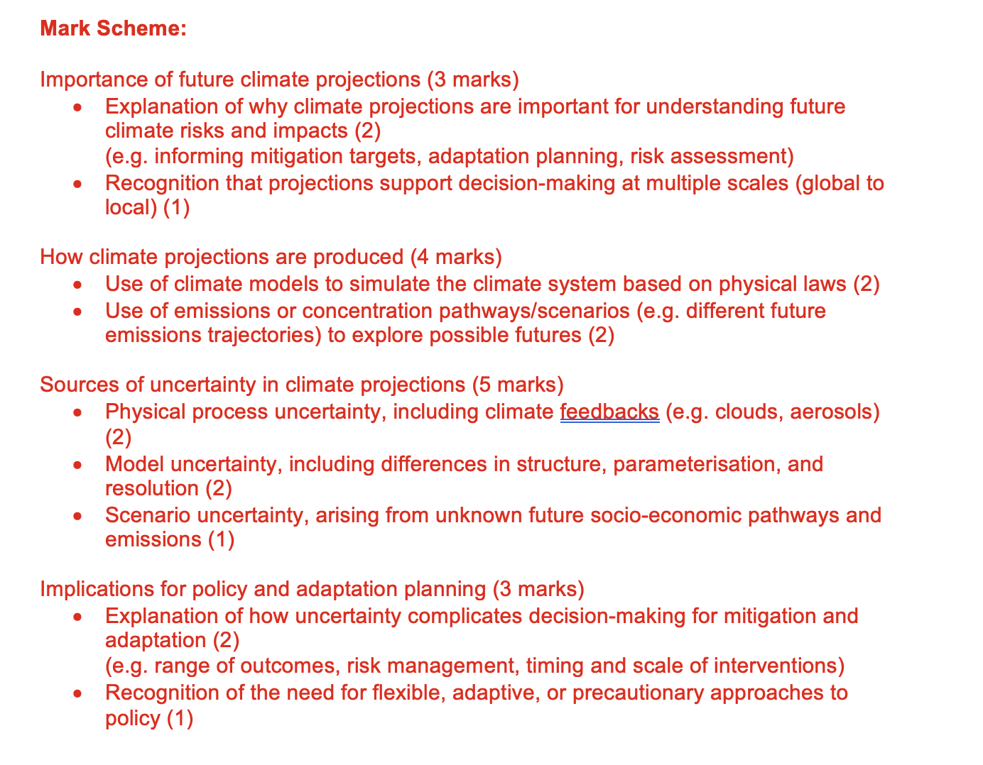
Not needed!

Slide 4
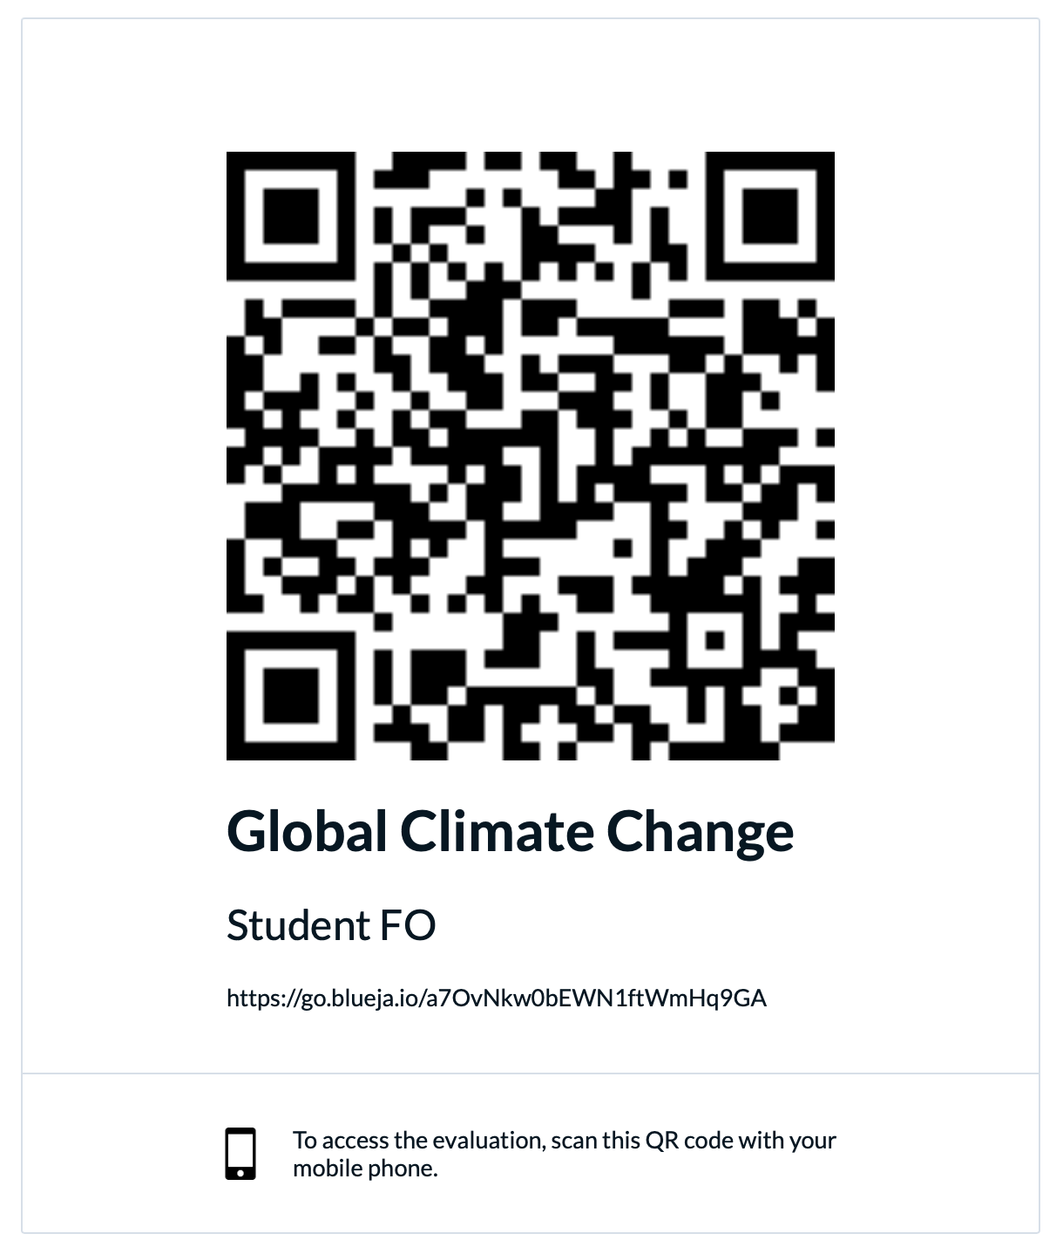

Slide 5

Intended Learning Outcomes
By the end of this week you will be able to:
Describe how we set global mitigation targets and discuss how different pathways can achieve these targets.
List different sources of anthropogenic greenhouse gas emissions and discuss how these can be reduced in different sectors.
Describe different ways in which negative emissions can be achieved and discuss the advantages and disadvantages of different approaches.

Slide 6

Today’s session
  Part 1: Impacts of climate change (10 mins)
  Part 2: Decisions on climate change (20 mins)
  Part 3: Mitigation Strategies (10 mins)
  Part 4: Break (10 mins)
  Part 5: Workshop (50 mins)

Slide 7

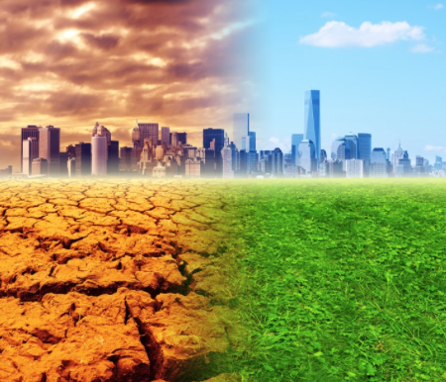
What impact will Climate Change have?
Increase Earth's average temperature
Influence the patterns and amounts of precipitation
Reduce ice and snow cover, as well as permafrost
Raise sea level
Increase the acidity of the oceans
Increase the frequency, intensity of extreme events
Shift ecosystem characteristics
Increase threats to human health
What will this depend on?
Increase in greenhouse gas concentrations
Other Anthropogenic radiative forcing effects
Natural influences on climate
Mitigations
Models of the climate system to better understand these issues and project future climate changes

Slide 8
What impact will Climate Change have?
Increase Earth's average temperature
Influence the patterns and amounts of precipitation
Reduce ice and snow cover, as well as permafrost
Raise sea level
Increase the acidity of the oceans
Increase the frequency, intensity of extreme events
Shift ecosystem characteristics
Increase threats to human health
What will this depend on?
Increase in greenhouse gas concentrations (weeks 1-5)
Other Anthropogenic radiative forcing effects (weeks 1-5)
Natural influences on climate (week 7)
Mitigations (week 9)
Models of the climate system to better understand these issues and project future climate changes (week 6).

Slide 9
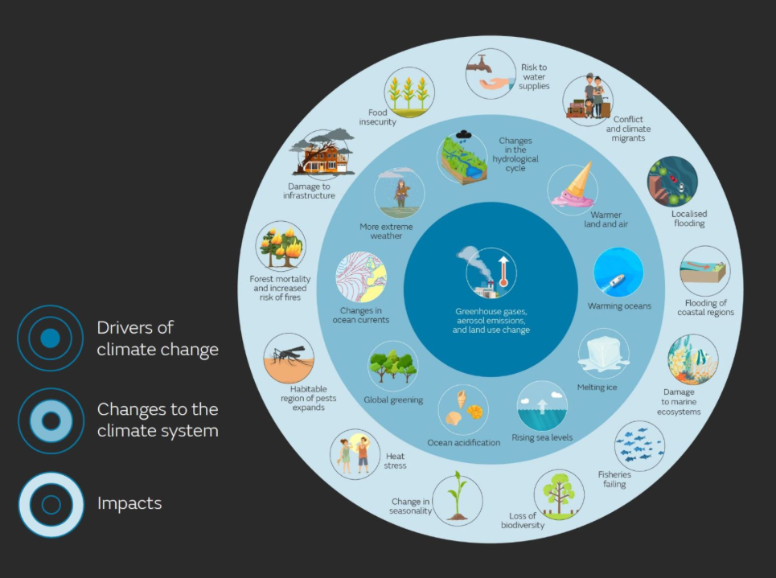

Slide 10
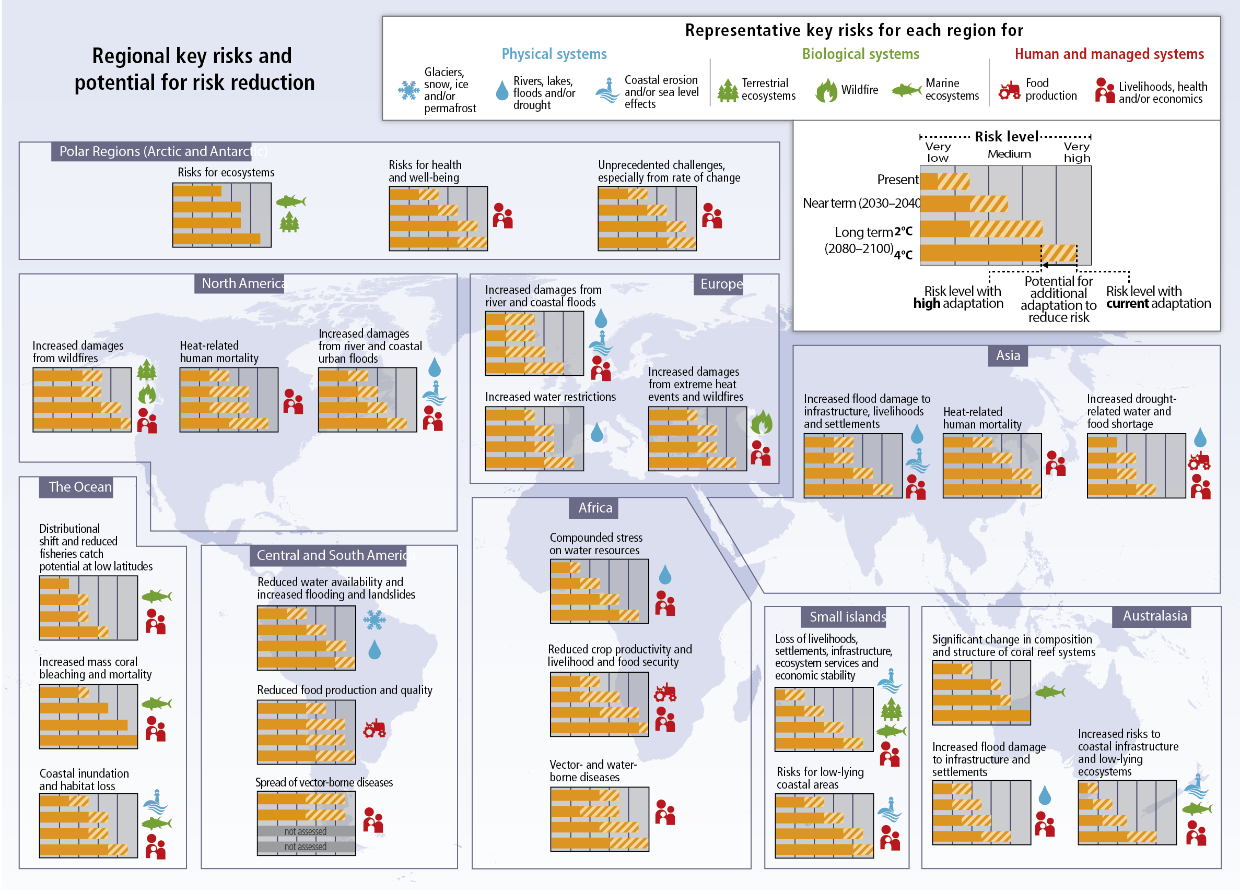

Slide 11
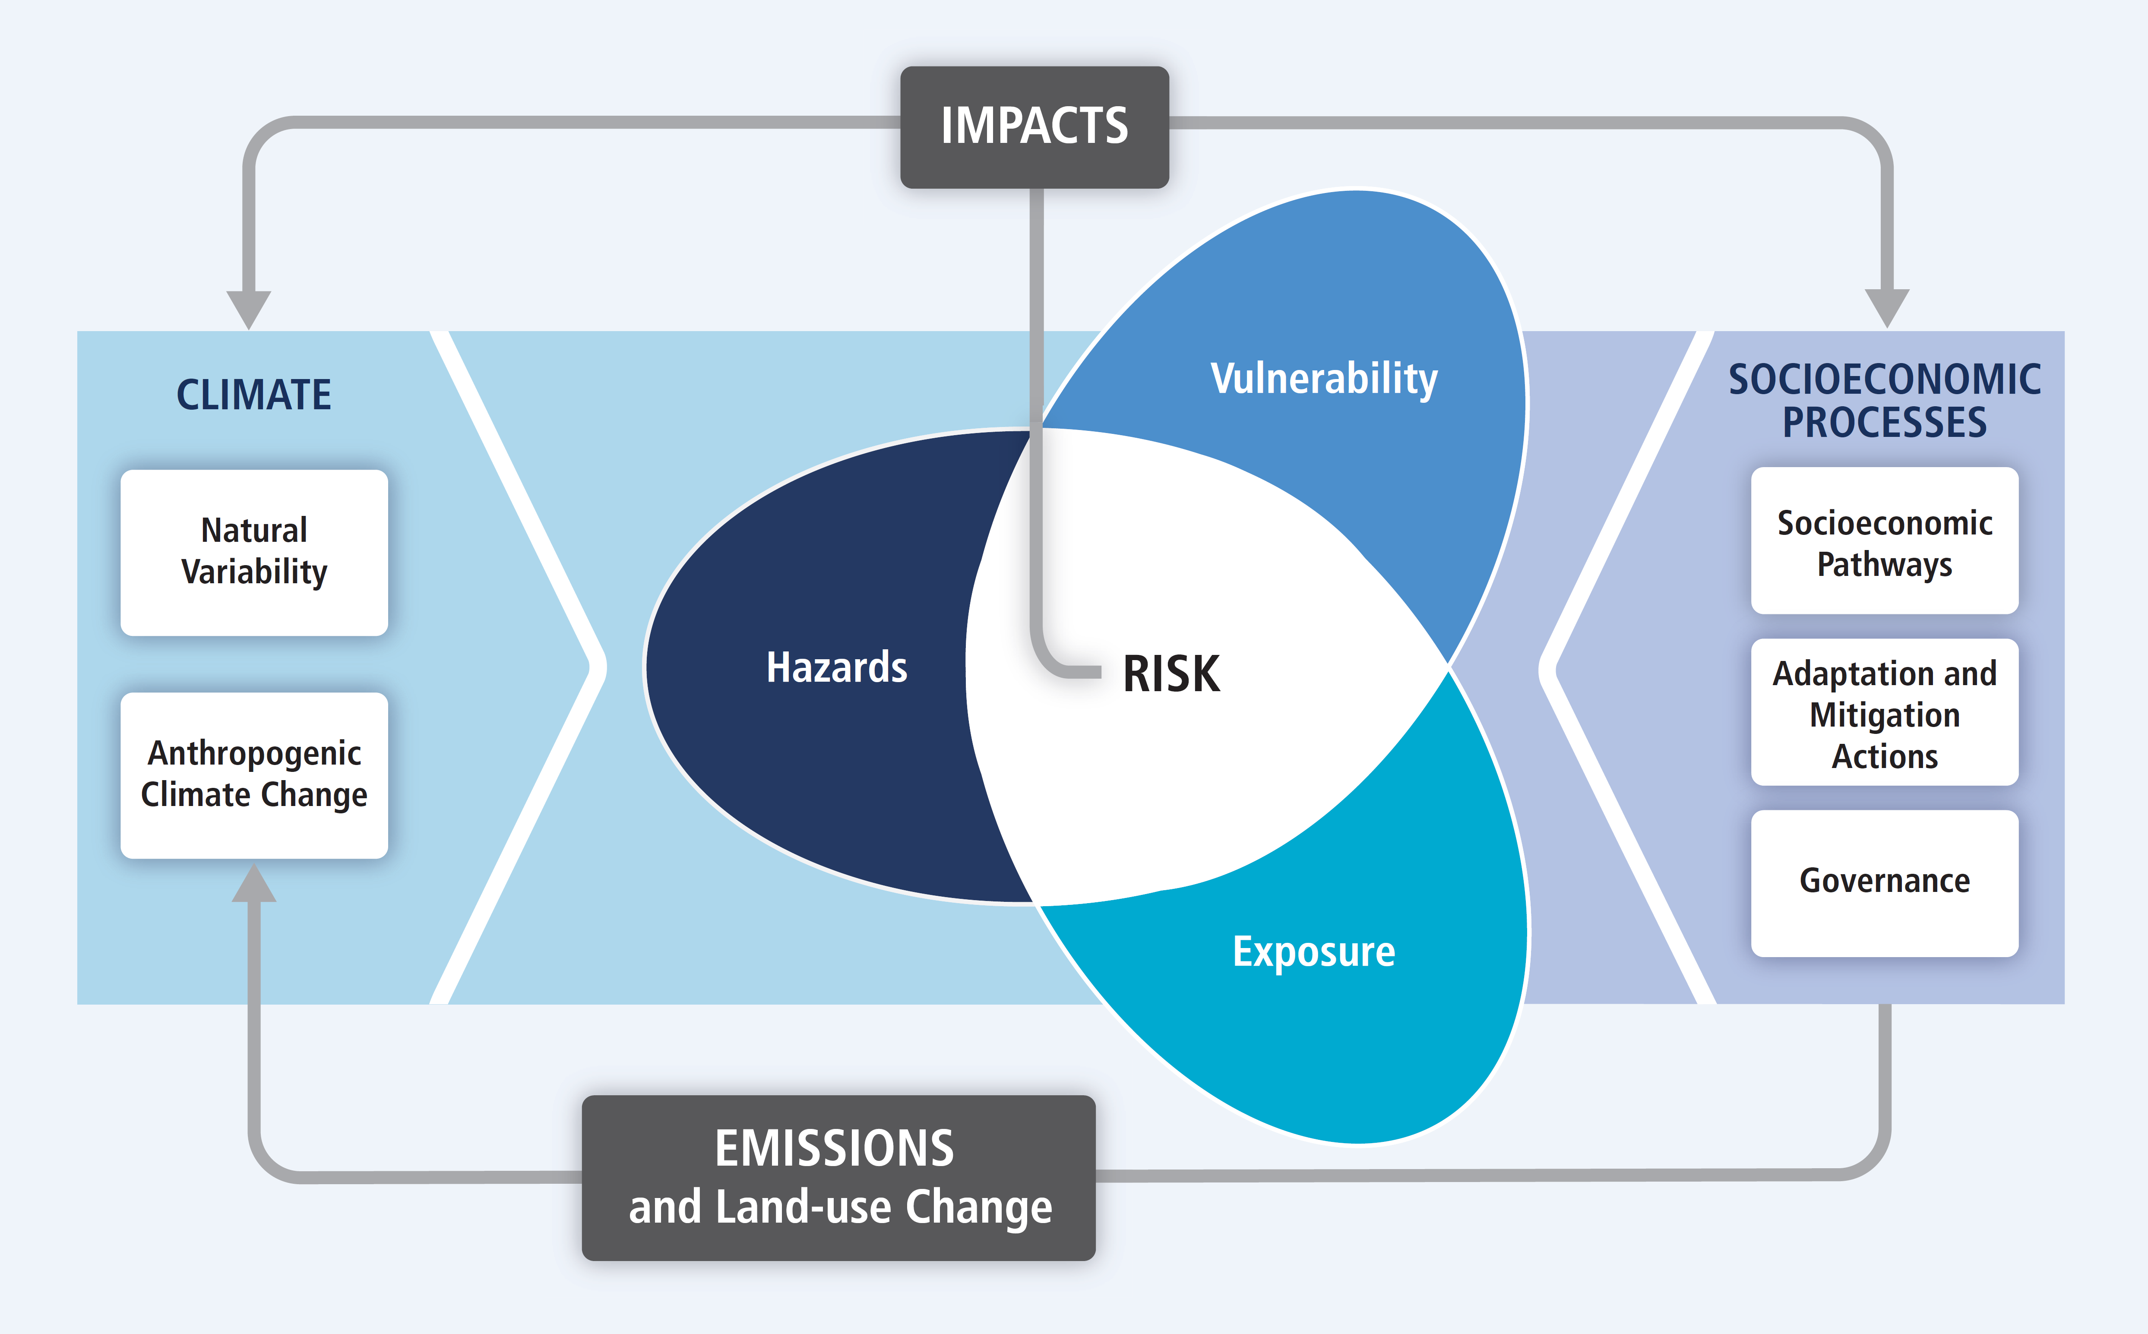
Climate Change Vulnerability
Vulnerability
Susceptibility to harm, resilience and the capacity to cope and adapt to hazards.

Slide 12
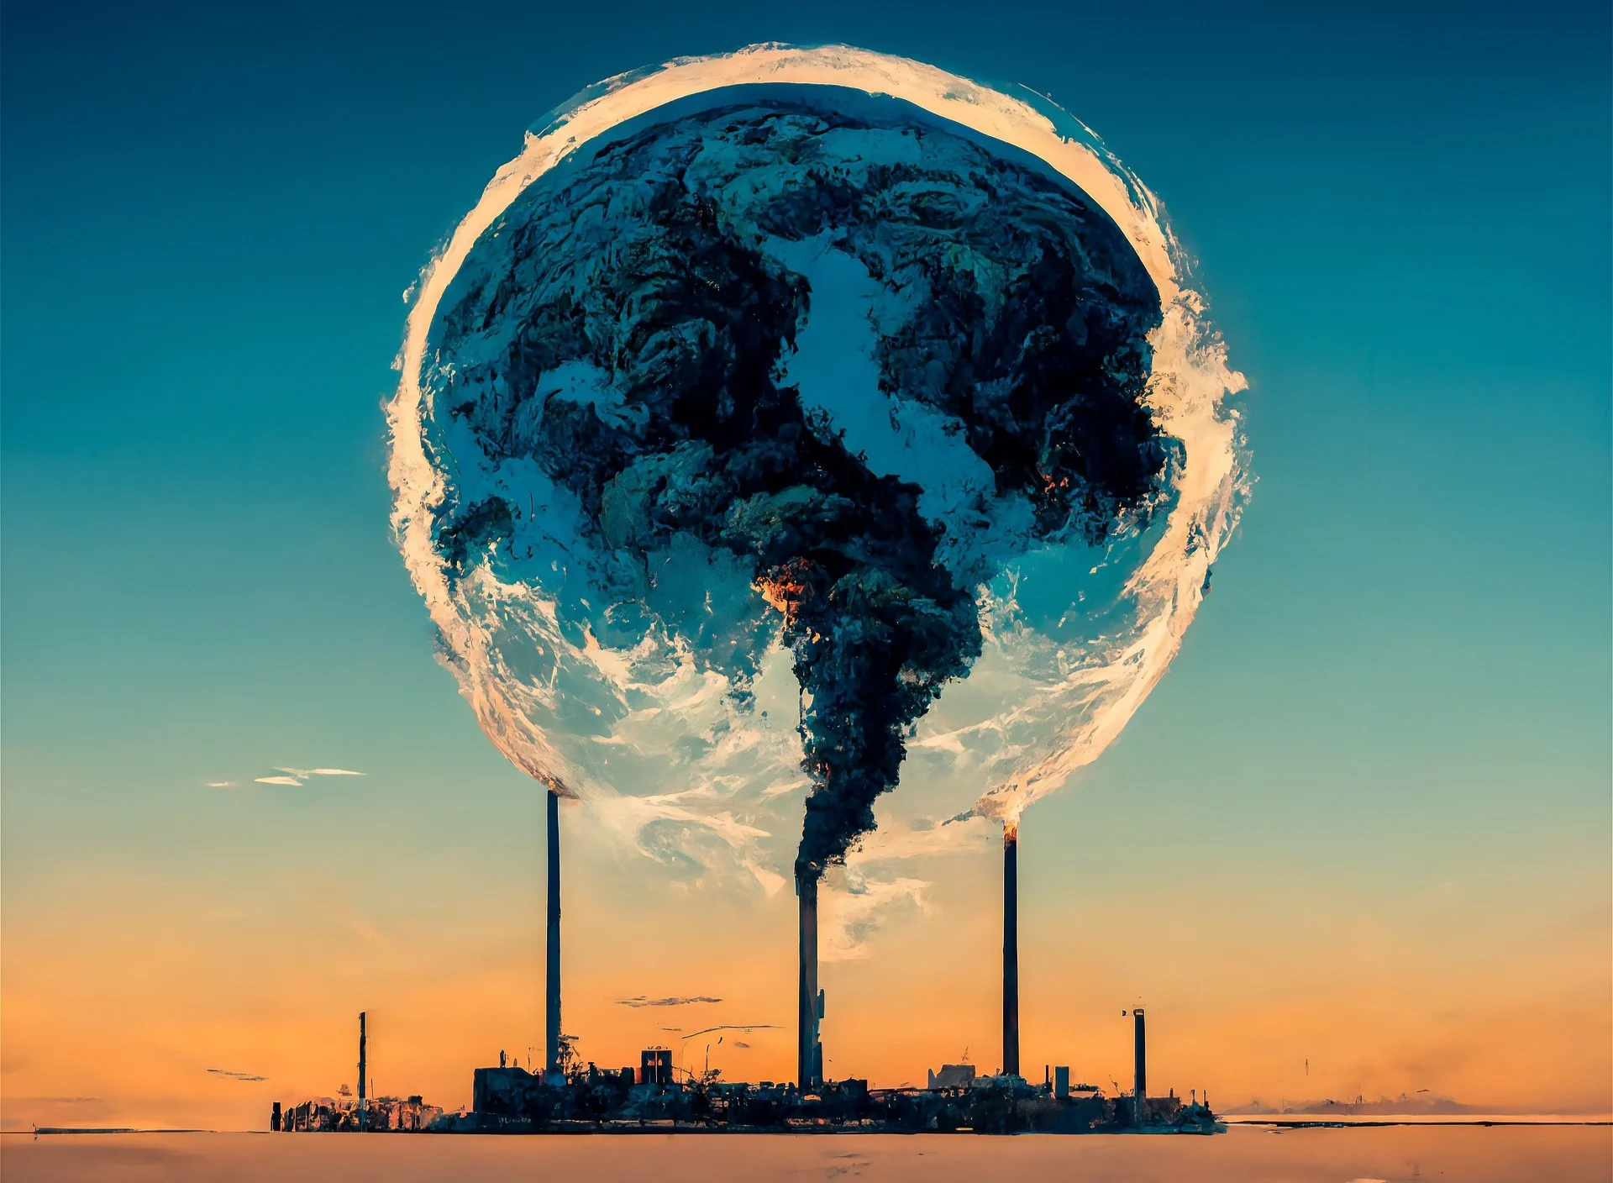
What can we do?
We are already committed to some level of climate change, responding to climate change involves a two-pronged approach:
Adaptation: adapting to life in a changing climate.
The goal is to reduce our risks from the harmful effects of climate change
It also includes making the most of any potential beneficial opportunities associated with climate change (for example, longer growing seasons or increased yields in some regions).
Mitigation: reducing climate change.
involves reducing the flow of greenhouse gases into the atmosphere, either by reducing sources of these gases (for example, the burning of fossil fuels for electricity, heat, or transport) or enhancing the “sinks” that accumulate and store these gases (such as the oceans, forests, and soil).

Slide 13
What can we do?
We are already committed to some level of climate change, responding to climate change involves a two-pronged approach:
Adaptation: adapting to life in a changing climate.
Mitigation: reducing climate change.
Both approaches are needed to respond to climate change!
Aim to keep temperature increases well below 2°C and pursue efforts to limit the temperature increase to 1.5°C
Given the lifetime of the pollutants, international collaboration is required to achieve this

Slide 14
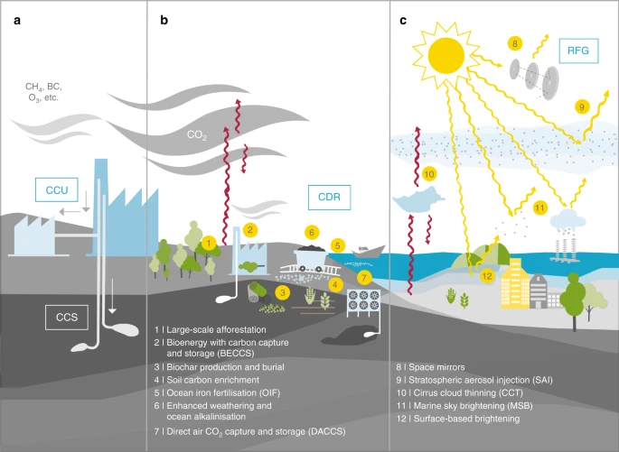
Could we do something about it?
Afforestation Bioenergy with carbon capture
Biochar production and burial
Soil carbon enrichment
Ocean iron fertilisation (OIF)
Enhanced weathering and ocean alkalinisation
Space mirrors
Stratospheric aerosol injection (SAI)
Cirrus cloud thinning (CCT)
Marine sky brightening (MSB)
Surface-based brightening
Direct air CO₂ capture and storage (DACCS)
Lawrence et al., 2018, Nature Communications

Slide 15
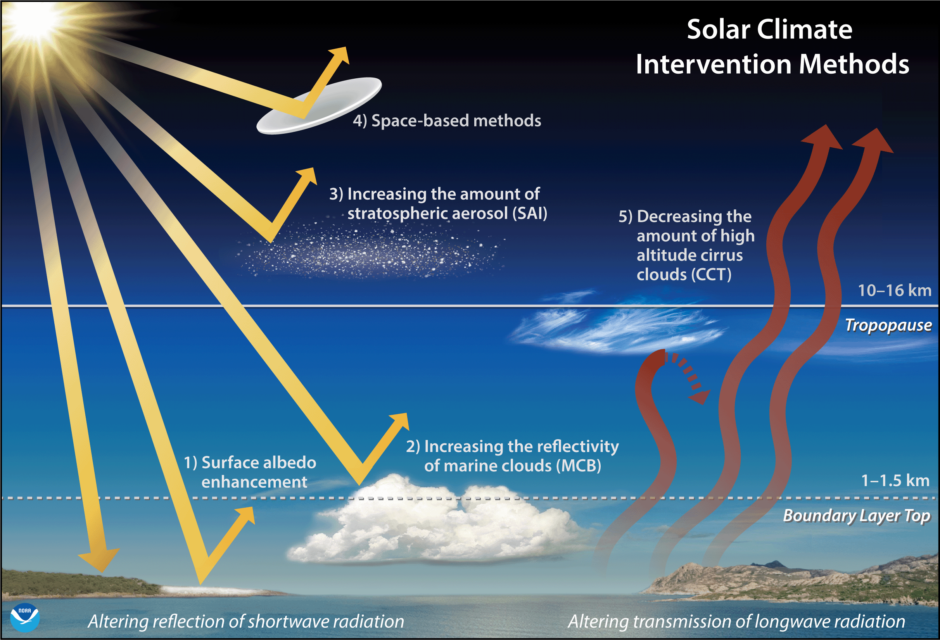

Slide 16
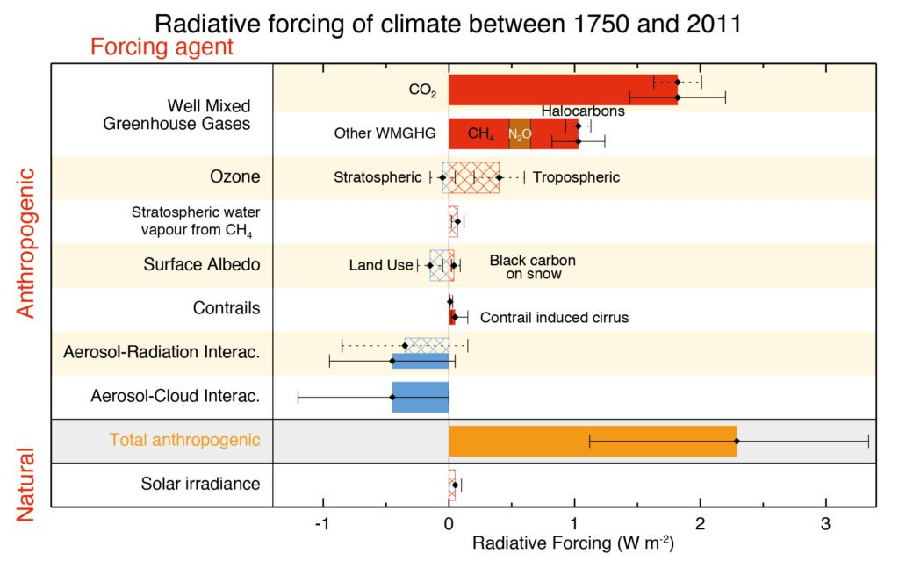
How much CO₂ can we emit?
Figure TS.6, AR5 WG1 technical summary report

Slide 17
Climate Sensitivity
This is defined as: The change in global mean surface temperature at equilibrium that is caused by a doubling of the atmospheric CO₂ concentration.

Slide 18
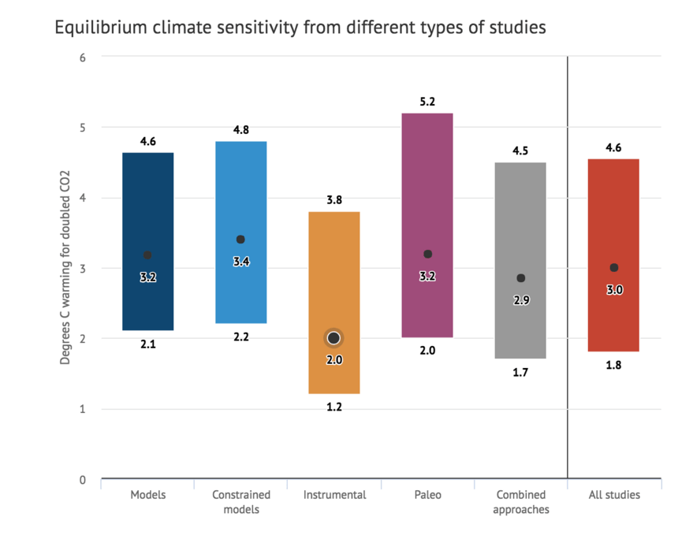
Climate Sensitivity
This is defined as: The change in global mean surface temperature at equilibrium that is caused by a doubling of the atmospheric CO₂ concentration.
CO₂ concentrations:
Preindustrial (1750s): 280 ppm
Current: 425 ppm
2 x CO₂ (2060s?): 560 ppm

Slide 19
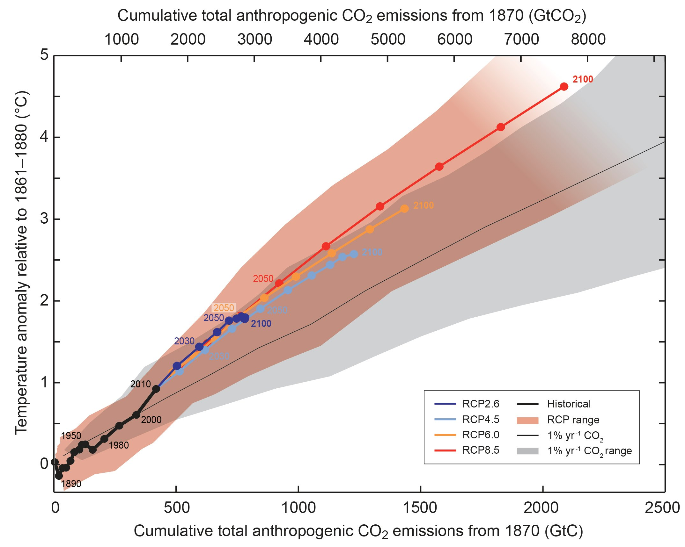
Climate Sensitivity
How do we calculate long term climate change from GHG emissions?
Every 1000 GtC → 1.5 – 2.5°C
Approximate ‘budget’ to limit warming to 2°C
~20 GtC emitted each year
500 GtC already emitted up to today.
NOTE: 1 GtC = 3.66 GtCO₂
adapted from Figure 2.3, AR5 synthesis report

Slide 20
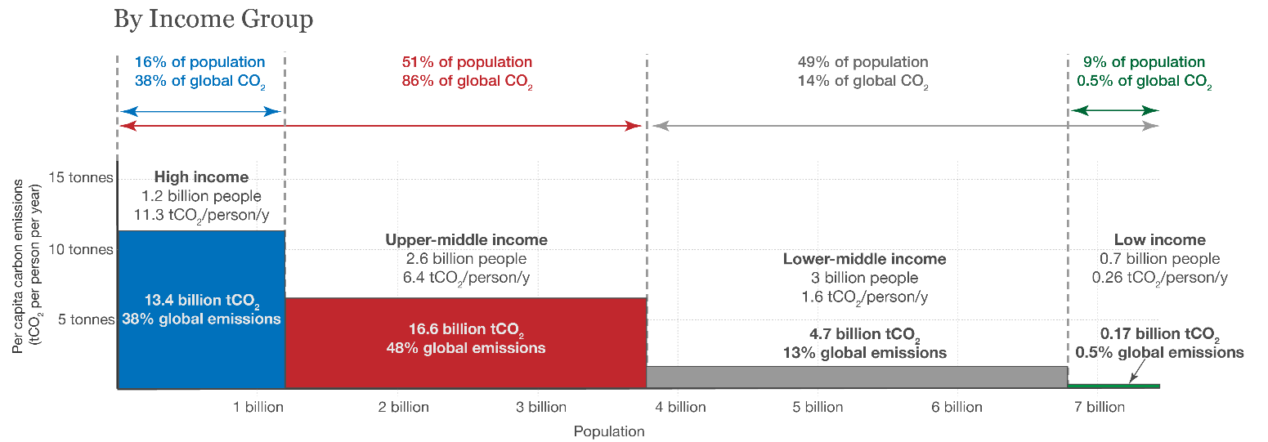
GHG Emissions per capita

Slide 21
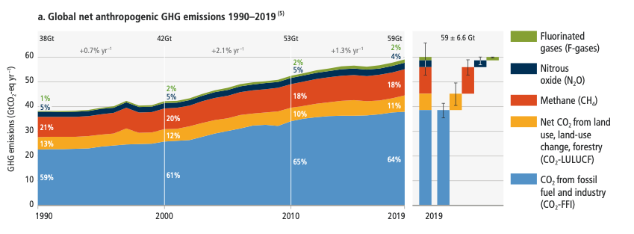
GHG, Annual Global Emissions
Anthropogenic GHG emissions kept increasing between 2010 and 2019.
The average annual GHG emissions in the 2010s were the highest of any decade on record.
Although emissions grew in the 2010s, they did so at a slower pace compared to the 2000s.

Slide 22
GHG, Annual Global Emissions
Net anthropogenic GHG emissions have increased since 2010 across all major sectors globally.
Emissions reductions in CO2 from fossil fuels and industrial processes, due to improvements in carbon intensity of energy, have been less than emissions increases from rising global activity levels in industry, energy supply, transport, agriculture and buildings.

Slide 23
Discussion
You are advising the UK government:
Which sector (energy, transport, industry, buildings, agriculture) should be prioritised for mitigation, and why?
What evidence would you use to support your recommendation, and what trade-offs might you face?
10 mins

Slide 24

IPCC and UNFCC
Near universal membership (196 countries + EU)
Ultimate objective:
“... stabilisation of greenhouse gas concentrations in the atmosphere at a level that would prevent dangerous anthropogenic interference with the climate system ...”
Annual Conference of Parties (COP) where they monitor, assess, and create action
1997 (COP 3) - Kyoto protocol: first binding GHG reduction targets for industrialised countries.
2015 (COP 21) – Paris agreement: Aim to keep temperatures “well below 2° C” and “pursue efforts to limit the temperature increase to 1.5° C”.
Notes:
We now know how much CO2 we can release, we know one country cannot control its own climate change, so who does decide this?

Slide 25

IPCC
Summary of science on climate change and its impacts
Temperature targets are not scientific targets, they are the result of a negotiated political process

Slide 26
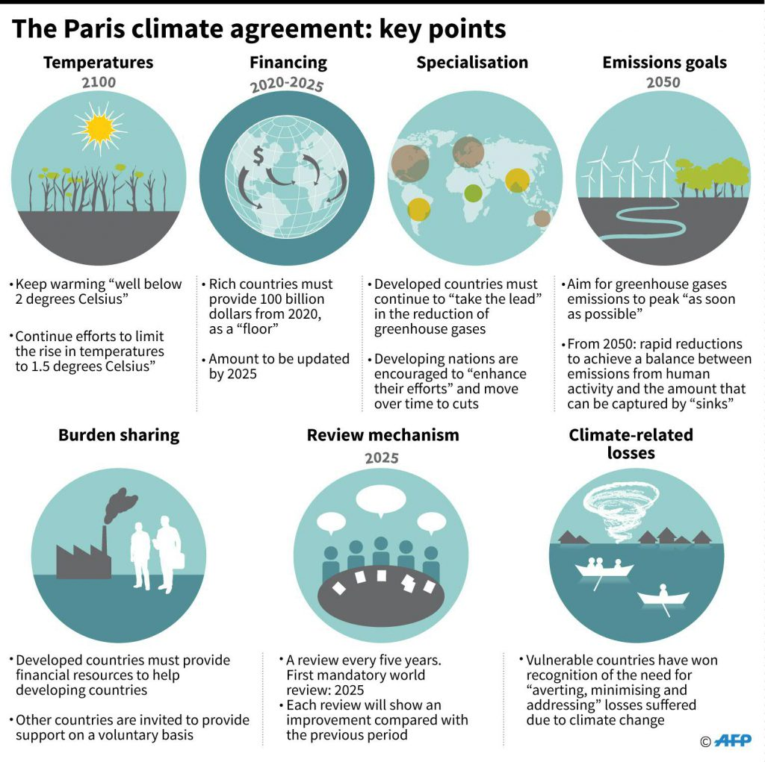
Ongoing efforts….
Aim to keep temperature increases well below 2°C and pursue efforts to limit the temperature increase to 1.5°C

Slide 27
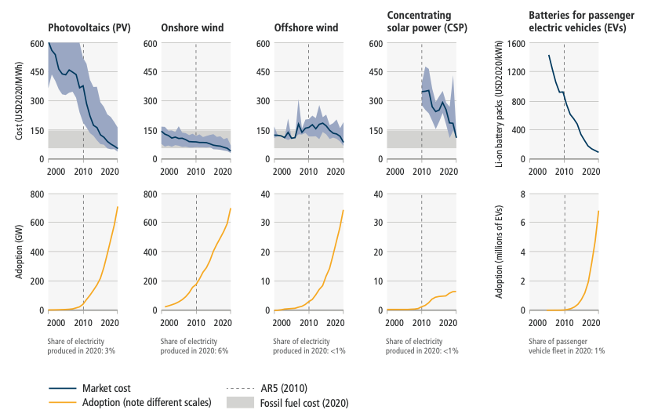
Ongoing efforts….
There has been a consistent expansion of policies and laws addressing mitigation since this agreement.
This has led to the avoidance of emissions that would otherwise have occurred and increased investment in low-GHG technologies and infrastructure.
Unit cost reductions and use in some rapidly changing mitigation technologies

Slide 28
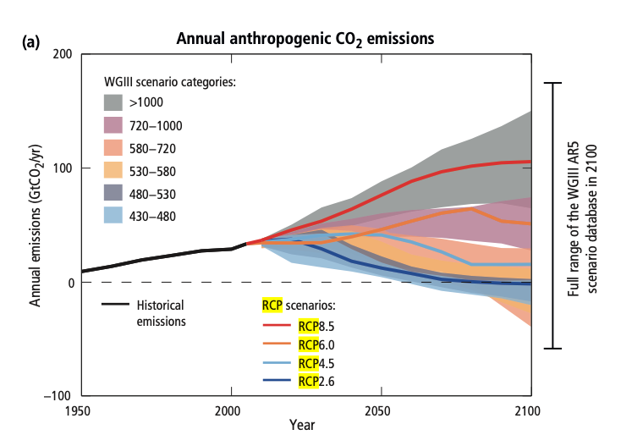
Representative Concentration Pathways
Anthropogenic GHG emissions are mainly driven by population size, economic activity, lifestyle, energy use, land use patterns, technology and climate policy.
The RCPs include a stringent mitigation scenario (RCP2.6)
two intermediate scenarios (RCP4.5 and RCP6.0)
very high GHG emissions (RCP8.5).
Scenarios without additional efforts to constrain emissions (’baseline scenarios’) lead to pathways ranging between RCP6.0 and RCP8.5.
RCP2.6 is representative of a scenario that aims to keep global warming likely below 2°C above pre-industrial temperatures.

Slide 29
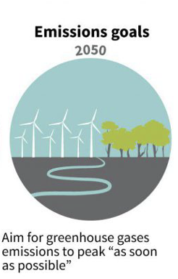
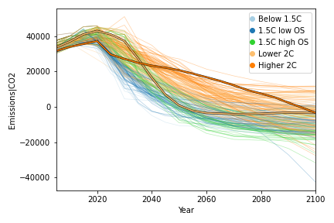
Emission Pathways with <2ºC warming in 2100
This plot shows all the model simulations from the AR5 report, that are below 2 degrees warming, and the pathway that was used to get there

Slide 30
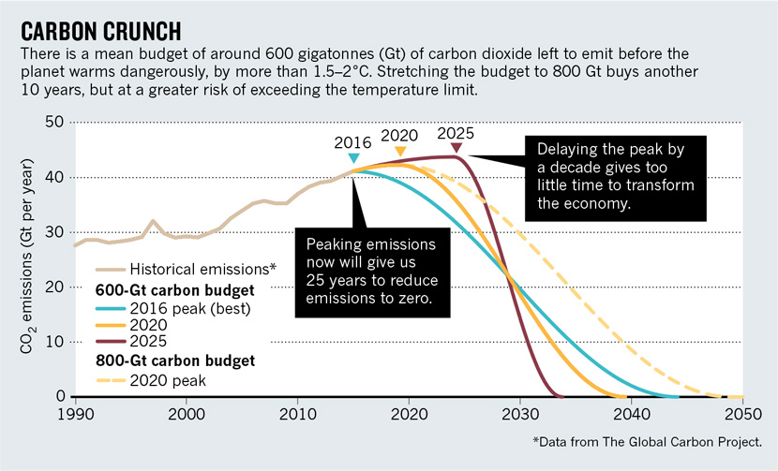
Emission Pathways and Peak Emissions
https://www.carbonbrief.org/mission-2020-new-global-strategy-rapidly-reduce-carbon-emissions

Slide 31
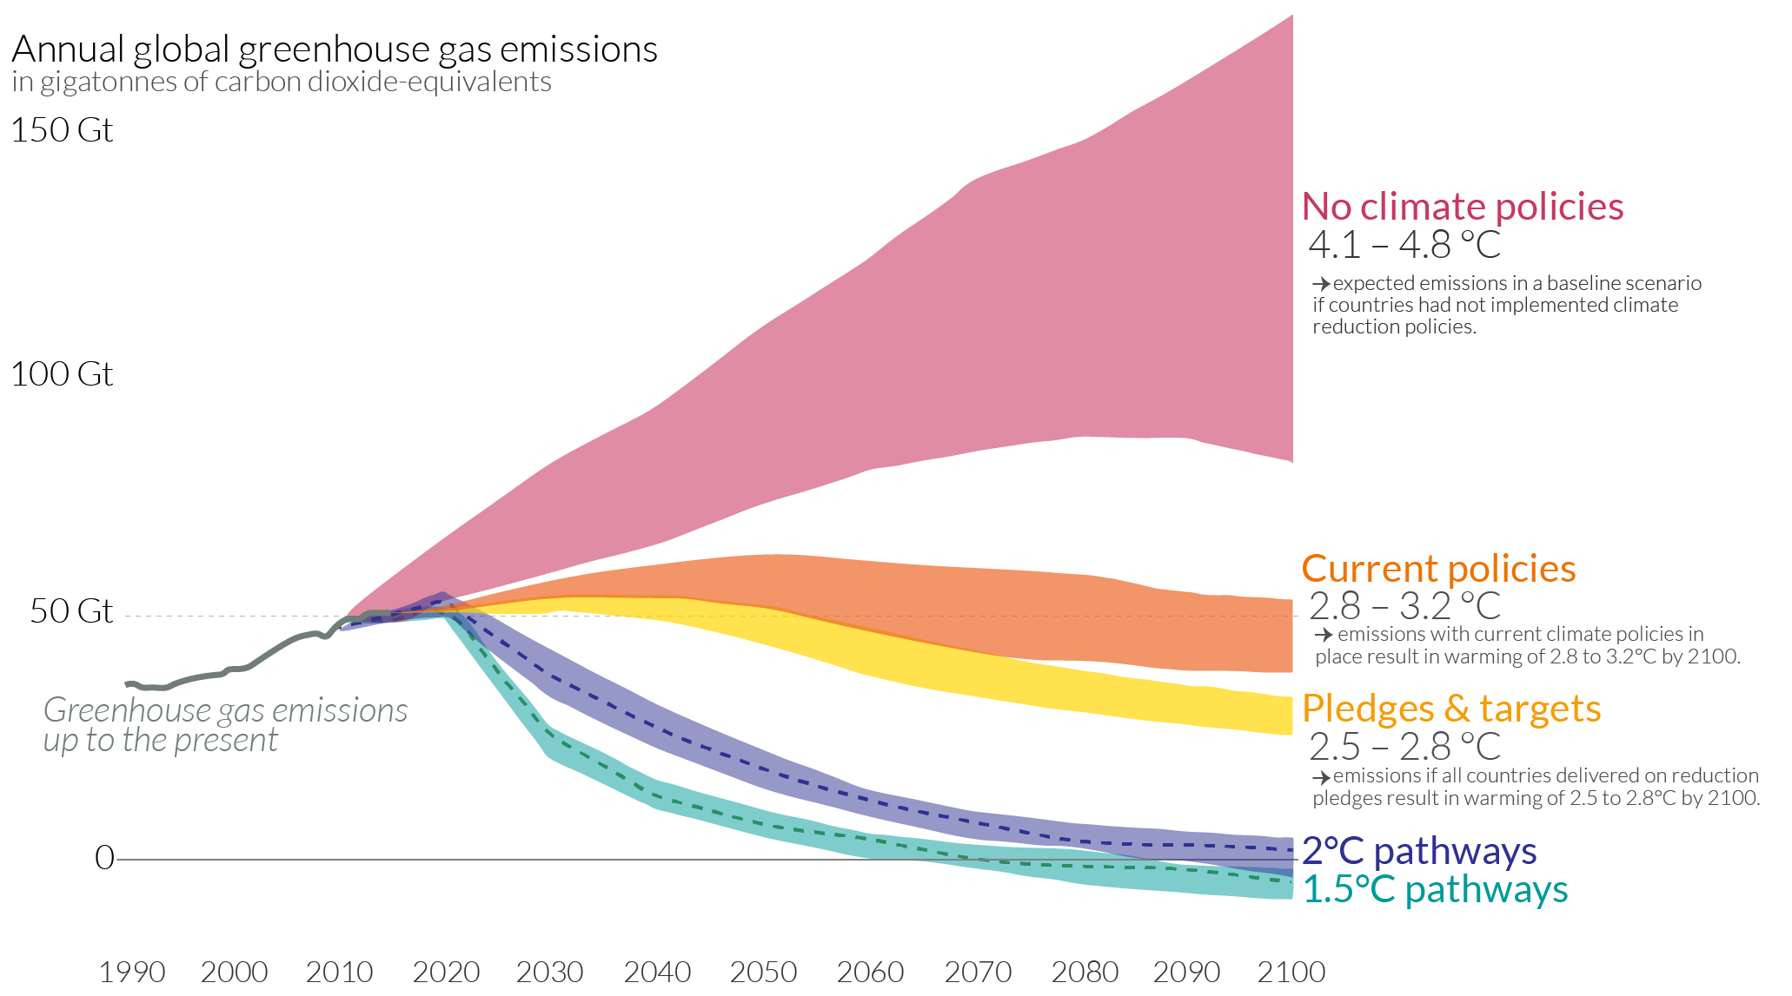
Future projections

Slide 32
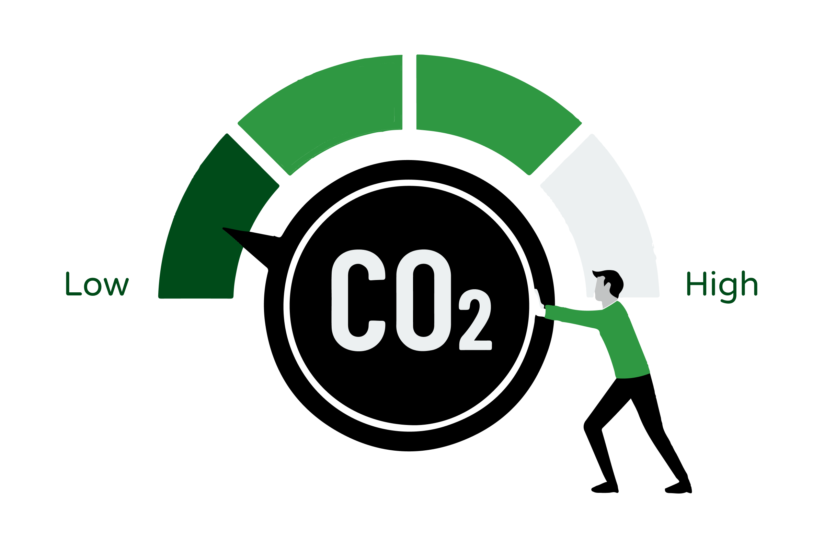
How do we reduce emissions?
Reduce demand for energy
  Less consumption
  Less travel
  Behavioural change in buildings
  Reduce food waste or eat less meat
Reduce carbon emissions associated with existing demand
  Low/zero-carbon energy and fuels
  Efficiency improvements (less energy, less use of materials, more use of products)
  Insulation
  Food additives or more productive breeds in livestock
Negative emission technologies
  Increased land uptake of carbon
  Bioenergy with CCS
  Increased ocean uptake of carbon
  Direct air capture and storage
  Storing carbon in the built environment

Slide 33
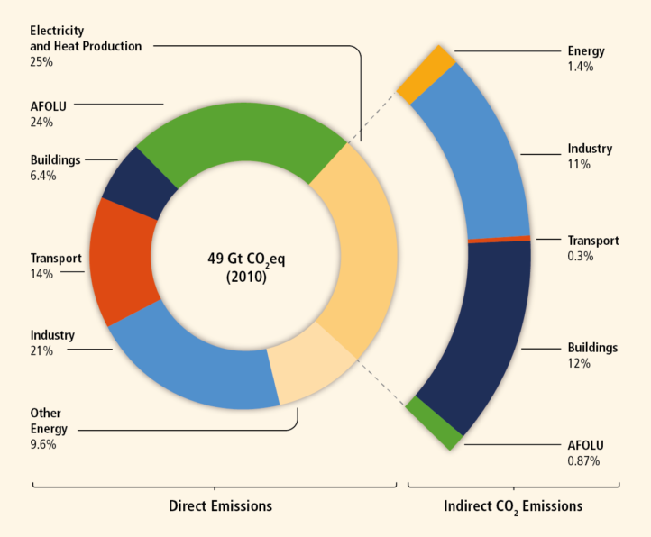
Global GHG emissions by sector
In order to better understand where we need to place our efforts, we need to know where the emissions are coming from
All global modelled pathways that limit warming to 2°C, involve rapid and deep and in most cases immediate GHG emission reductions in all sectors.
Figure 1.7, AR5 synthesis report
Notes:
Agriculture forestry and other land use

Slide 34
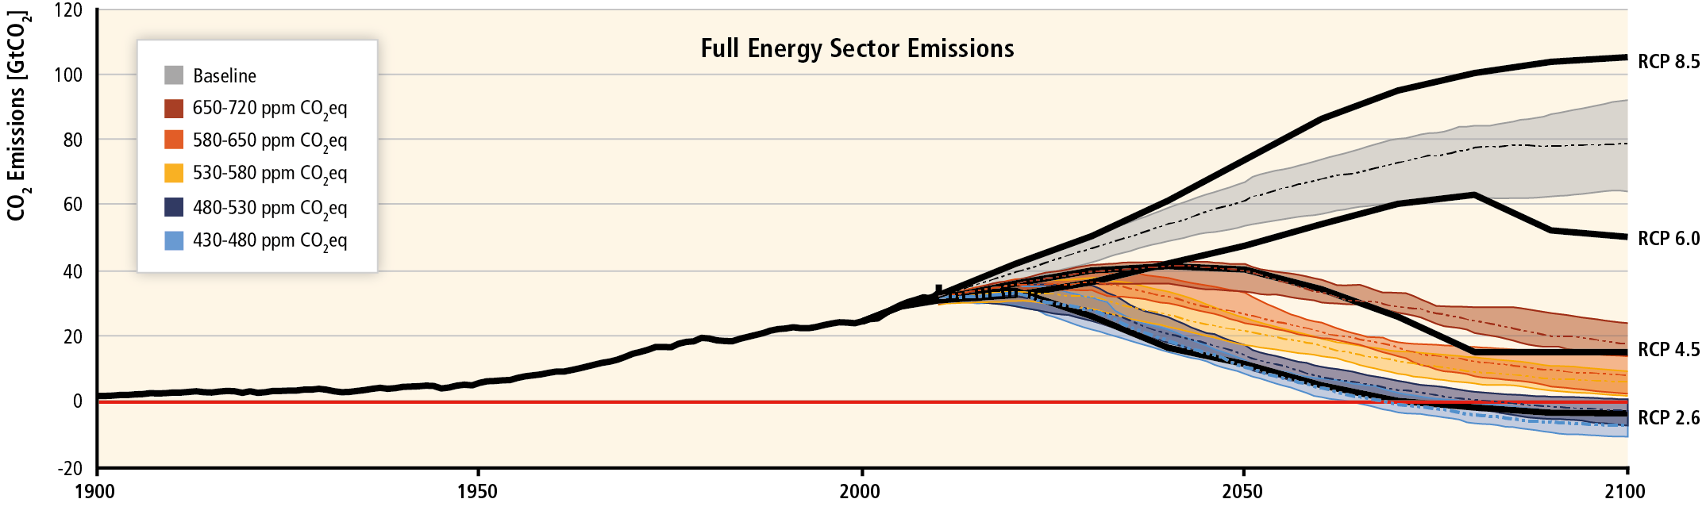
Global GHG emissions by sector - Energy
Figure 1.7, AR5 synthesis report
Notes:
Agriculture forestry and other land use

Slide 35
Energy Mitigation Options
Low-carbon electricity supply
Renewable energy
Nuclear
Often cost effective
Coal phaseout
Replacing coal with natural gas as a bridge technology.
Big switch to electrification, inducing cooking, transport and heating.
Carbon capture and storage
Would enable continued use of fossil fuels.
Questions on economic feasibility – more later
Demand reduction
Behavioural or lifestyle changes – see different sectors below.

Slide 36
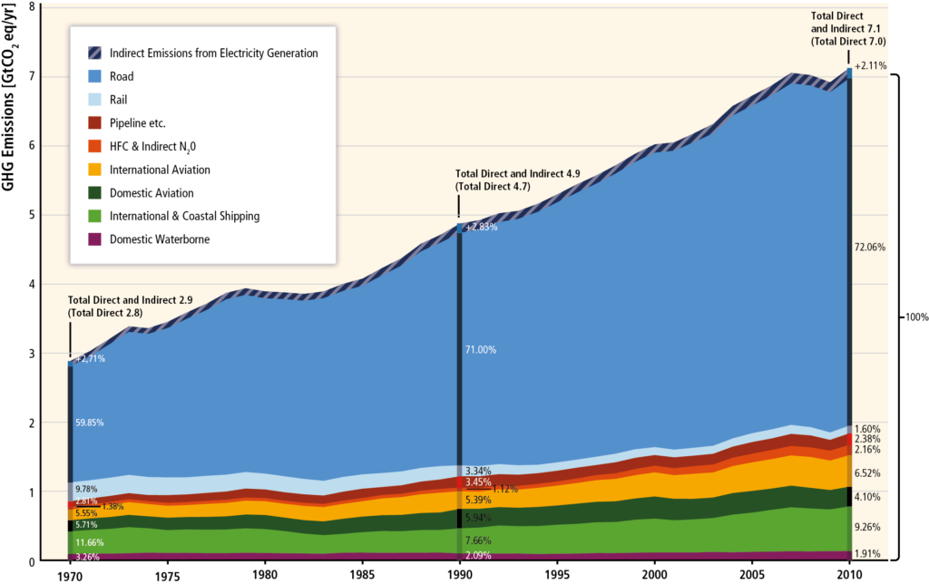
Global GHG, Emissions from transport (14%)
AR5 WG3 report

Slide 37
Transport Mitigation Options
Avoided journeys
More compact urban form
Sourcing localised products
Restructuring freight logistics systems
Virtual conferences
Model shift
Increasing investment in public transport, walking & cycling infrastructure
Modifying roads, airports, ports and railways
Lowering energy intensity
Enhancing vehicle & engine performance
Use lightweight materials
Increasing freight load factors & passenger occupancy rates
Deploying new technologies
Reducing carbon intensity of fuels
Substituting oil based products with lower carbon alternatives e.g. biofuels, electricity (EVs) or hydrogen produced from low GHG sources

Slide 38
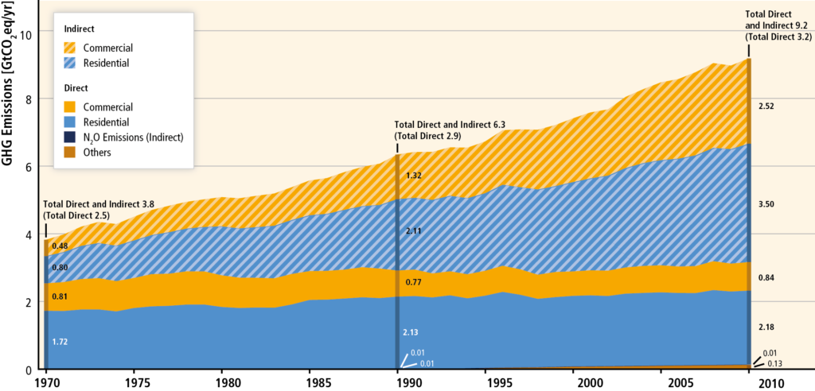
Global GHG, Emissions from buildings (19%)
AR5 WG3 report

Slide 39
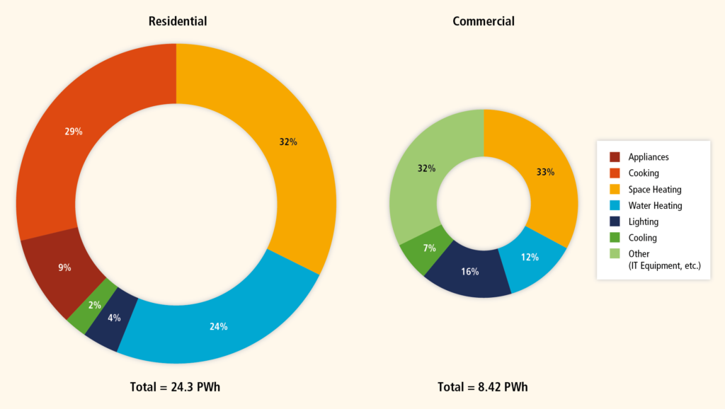
Global GHG, Emissions from buildings (19%)
Cooking and
water heating
Space heating
Cooling

Slide 40
Building Mitigation Options
Carbon efficiency
Building integrated renewable energy solutions
Switching to low carbon fuels
Advanced biomass stoves
Energy efficiency
Insulation
Efficient heating and cooling systems
Efficient appliances
Smart meters and grids
System efficiency
Urban planning
District heating/ cooling
Utilisation of waste heat
Passive housing standards
Net zero energy buildings
Service demand reduction
Behaviour change
Lifestyles change
Smart metering

Slide 41
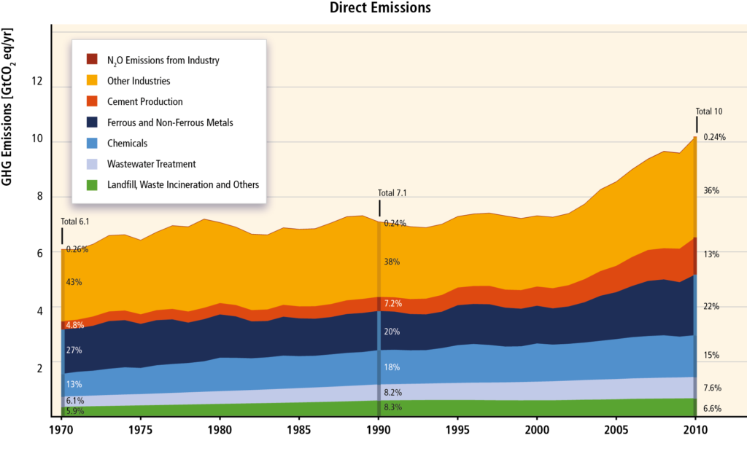
Global GHG, Emissions from industry (33%)
AR5 WG3 report

Slide 42
Industry Mitigation Options
Energy efficiency of industrial processes
Furnace insulation
Using outputs of one process to be used in another (e.g. material recycling)
Using low-carbon energy sources
Material efficiency
Reducing yield losses
Light-weight designs
Extended product life
Use products more intensively
Higher building occupancy
Car sharing
Reducing food waste
Demand
Reduce unnecessary consumption (e.g. fast fashion)
Travel less

Slide 43
How do we reduce emissions?
Reduce demand for energy
Reduce carbon emissions associated with existing demand
Negative emission technologies
  Increased land uptake of carbon
  Bioenergy with CCS
  Increased ocean uptake of carbon
  Direct air capture and storage
  Storing carbon in the built environment

Slide 44
Role of NET’s in Mitigation Policy
Shape of pathway depends on the timing and mix of mitigation policies

Slide 45
Role of NET’s in Mitigation Policy
Need for NETs to:
Offset emissions that cannot be reduced to zero.
Undo the effects of past emissions.
But there are huge risks in thinking they are the solution:
Never implemented at scale.
Research or deployment of NETs can delay or deter action to reduce GHG emissions.
Use of ‘net zero’ as a target often hides excessive reliance on NETs.
Promises of future carbon removal later instead of reducing emissions now are essentially a huge gamble with future generations paying the cost

Slide 46
Could we do something about it?
Afforestation Bioenergy with carbon capture
Biochar production and burial
Soil carbon enrichment
Ocean iron fertilisation (OIF)
Enhanced weathering and ocean alkalinisation
Space mirrors
Stratospheric aerosol injection (SAI)
Cirrus cloud thinning (CCT)
Marine sky brightening (MSB)
Surface-based brightening
Direct air CO₂ capture and storage (DACCS)
Lawrence et al., 2018, Nature Communications

Slide 47
Lecture Summary
Climate change mitigation aims to limit future warming by reducing greenhouse gas emissions and enhancing carbon sinks.
Achieving these targets depends on cumulative emissions
Mitigation strategies include reducing energy demand, improving efficiency, transitioning to low- or zero-carbon energy sources, and changing behaviours.
Different sectors require different approaches, and prioritisation depends on factors such as emission magnitude, feasibility, and cost.
Negative Emission Technologies (NETs) will be needed meet climate targets, but they are uncertain, costly, and not yet deployed at scale.
Overreliance on NETs presents significant risks and may delay immediate mitigation efforts.
Effective mitigation requires coordinated global action, informed decision-making, and consideration of trade-offs between technological, economic, and societal factors.

Slide 48
Comments/Questions/Revision

Slide 49
Example Exam Themes
Describe the difference between adaptation and mitigation
Give an example of where a positive change to mitigate against climate change could also have air quality co-benefits
Give an example of where a positive change to mitigate against climate change could also have air quality disbenefits
Discuss the role of different sectors (e.g. energy, transport, industry, buildings) in contributing to global greenhouse gas emissions, and evaluate which sector offers the greatest mitigation potential.
Evaluate the advantages and limitations of renewable energy as a mitigation strategy.
Discuss the challenges associated with transitioning to a low-carbon energy system.
Explain the concept of emissions pathways (e.g. RCPs) and describe how they are used to inform climate policy.
Assess the role of behavioural change in reducing greenhouse gas emissions. Provide examples.
Discuss the potential benefits and drawbacks of carbon capture and storage (CCS) as a mitigation strategy.
Evaluate the role of international agreements (e.g. the Paris Agreement) in achieving global mitigation targets.

Slide 50
Week 10: Climate Change Case Studies
Agricultural practices and climate change (impacts, adaptation, mitigation)
Marine cloud brightening as a climate intervention strategy
Focus on real-world applications and implications of both approaches
Evaluation of benefits, risks, and potential unintended consequences
Links to policy, sustainability, and future climate solutions

Slide 51


Thank you
Thomas.Bannan@Manchester.ac.uk
Notes:
Post-training evaluation survey

Slide 52
Q1.
Who Should Pay for Global Mitigation: Polluters Past, Present or Future?

Slide 53
Q2.
Should adaptation be prioritised over mitigation?

Slide 54
Q3.
How can education empower individuals and communities to adapt to climate change?

Slide 55
Q4.
Compare emissions and mitigation potential from key sectors: energy, transport, agriculture, industry, and buildings.

Slide 56
Q5.
How can urban areas be redesigned to cope with floods, heatwaves, and storms?

Slide 57
Q6.
Is individual action (e.g. flying less, eating less meat) meaningful, or is it a distraction from wider larger change?

Slide 58
Q7.
Why Do We Need Negative Emission Strategies?

Slide 59
Q8.
What information would you need to decide whether a mitigation strategy is “worth it”?

Slide 60
Q9.
Can you think of any real-world examples of successful mitigation strategies? What made them work?

Slide 61
Q10.
Is it realistic to achieve global net zero by 2050? What are the biggest barriers?

Slide 62
Q11.
Which is more effective for reducing emissions: technological innovation or behavioural change?

Slide 63
Q12.
Should governments prioritise short-term emission reductions or long-term technological solutions? Discuss the trade-offs.

